Slide 1
Node.js
By- Ginni Aggarwal

Slide 2
INDEX
Introduction
Features
Installation
Console
NPM
Call Back Concept
Blocking Code
Non Blocking Code
Event Loops
Event Driven Programming
EventEmitter
Event Module
Streams
File Sytem
Web Module
Creating a web server
Express Framework
Request and Response
Basic Routing
Serving Static Files

Slide 3
What is node.js
Node.js is a cross-platform environment and library for running JavaScript applications.
It is used to create networking and server-side applications.
It is a server-side platform built on Google Chrome's JavaScript Engine (V8 Engine).
Node.js applications are written in JavaScript, and can be run within the Node.js runtime on OS X, Microsoft Windows, and Linux.
Node.js also provides a rich library of various JavaScript modules
Node.js = Runtime Environment + JavaScript Library
Notes:
*

Slide 4
Node.js features
Asynchronous and Event Driven - All APIs of Node.js library are asynchronous, that is, non-blocking.
Very Fast - Being built on Google Chrome's V8 JavaScript Engine, Node.js library is very fast in code execution.
Single Threaded but Highly Scalable - Node.js uses a single threaded model with event looping.
No Buffering - Node.js applications never buffer any data.
License - Node.js is released under the MIT license.
Notes:
*

Slide 5
Where to use node.js
I/O bound Applications
Data Streaming Applications
Data Intensive Real-time Applications (DIRT)
JSON APIs based Applications
Single Page Applications
Notes:
*

Slide 6
Install Node.js on Windows
To install and setup an environment for Node.js, you need the following two softwares available on your computer:
Text Editor - This will be used to type your program. Examples of few editors include Windows Notepad, OS Edit command, Brief, Epsilon, EMACS, and vim or vi.
Node.js Binary installable - Node.js distribution comes as a binary installable for SunOS , Linux, Mac OS X, and Windows operating systems with the 32-bit (386) and 64-bit (amd64) x86 processor architectures.
Notes:
*

Slide 7
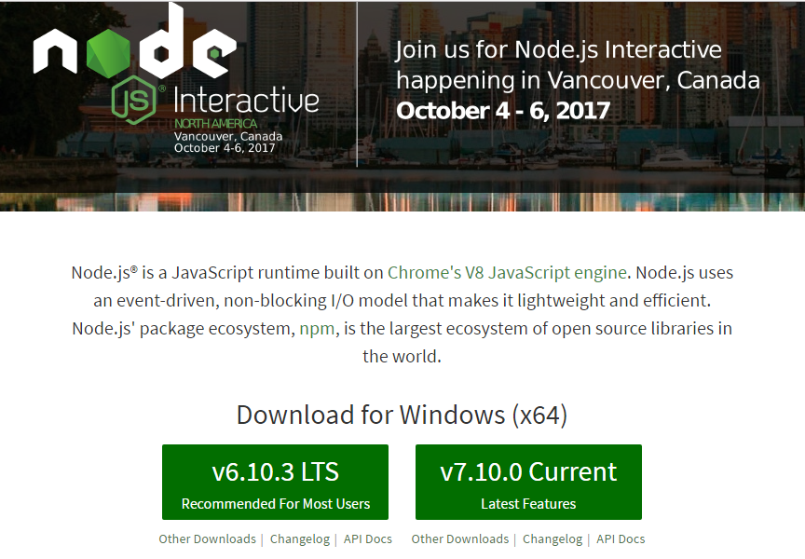
Install Node.js on Windows
Download the latest version of Node.js installable archive file from https://nodejs.org/en/
Notes:
*

Slide 8
Install Node.js on Windows
Here, you deploy the installation of node-v6.10.3 LTS recommended for most users.
Notes:
*

Slide 9
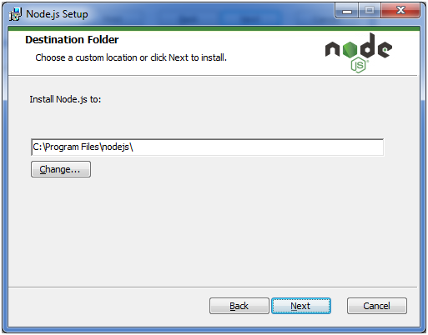
Install Node.js on Windows
Choose the location where you want to install.

Slide 10
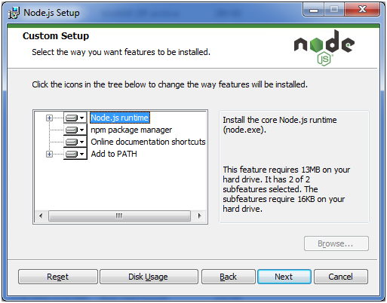
Install Node.js on Windows
Notes:
*

Slide 11
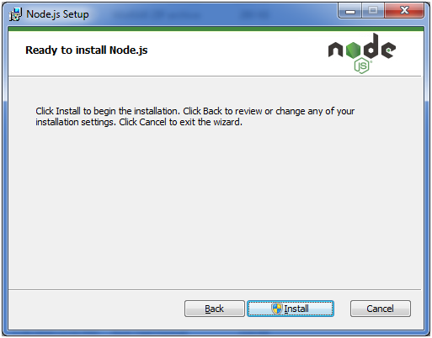
Install Node.js on Windows
Notes:
*

Slide 12
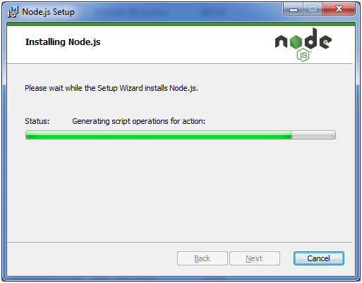
Install Node.js on Windows
Notes:
*

Slide 13
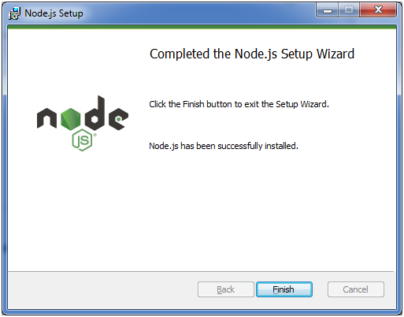
Install Node.js on Windows
Notes:
*

Slide 14
Node.js console
The Node.js console module provides a simple debugging console similar to JavaScript console mechanism provided by web browsers.
There are three console methods that are used to write any node.js stream:
console.log()
console.error()
console.warn()
Notes:
*

Slide 15
Node.js console.log()
The console.log() function is used to display simple message on console.
File: console_example1.js
/* Hello, World! program in node.js */
console.log("Hello, World!")
Notes:
*

Slide 16
Node.js console.error()
The console.error() function is used to render error message on console.
File: main.js
console.error("Error: There is an error");
Notes:
*

Slide 17
Node.js console.warn()
The console.warn() function is used to display warning message on console.
File: main.js
console.warn(`There may be some warning`);
Notes:
*

Slide 18
Node.js Package Manager
Node Package Manager provides two main functionalities:
It provides online repositories for node.js packages/modules which are searchable on search.nodejs.org
It also provides command line utility to install Node.js packages, do version management and dependency management of Node.js packages.
NPM comes bundled with Node.js installables after v0.6.3 version. To verify the same, open console and type the following command and see the result −
Notes:
*

Slide 19
Installing Modules using npm
Following is the syntax to install any Node.js module:
npm install <Module Name>
For example, following is the command to install a famous Node.js web framework module called express −
$ npm install express
Now you can use this module in your js file as following
var express = require('express');
Notes:
*

Slide 20
local installation
By default, npm installs dependency in local mode. Here local mode specifies the folder where Node application is present.
For example if you installed express module, it created node_modules directory in the current directory where it installed express module.
You can use npm ls command to list down all the locally installed modules.
Notes:
*

Slide 21
global installation
Globally installed packages/dependencies are stored in system directory.
Such dependencies can be used in CLI (Command Line Interface) function of any node.js but cannot be imported using require() in Node application directly.
Notes:
*

Slide 22
global installation
You can use npm ls -g command to list down all the globally installed modules.
Notes:
*

Slide 23
Uninstalling a Module
To uninstall a Node.js module, use the following command:
npm uninstall <Module Name>
Notes:
*

Slide 24
Package.json
package.json is present in the root directory of any Node application/module and is used to define the properties of a package.
This file is used to give information to npm that allows it to identify the project as well as handle the project's dependencies
Notes:
*

Slide 25
Package.json
package.json is present in the root directory of any Node application/module and is used to define the properties of a package.
This file is used to give information to npm that allows it to identify the project as well as handle the project's dependencies
Notes:
*

Slide 26
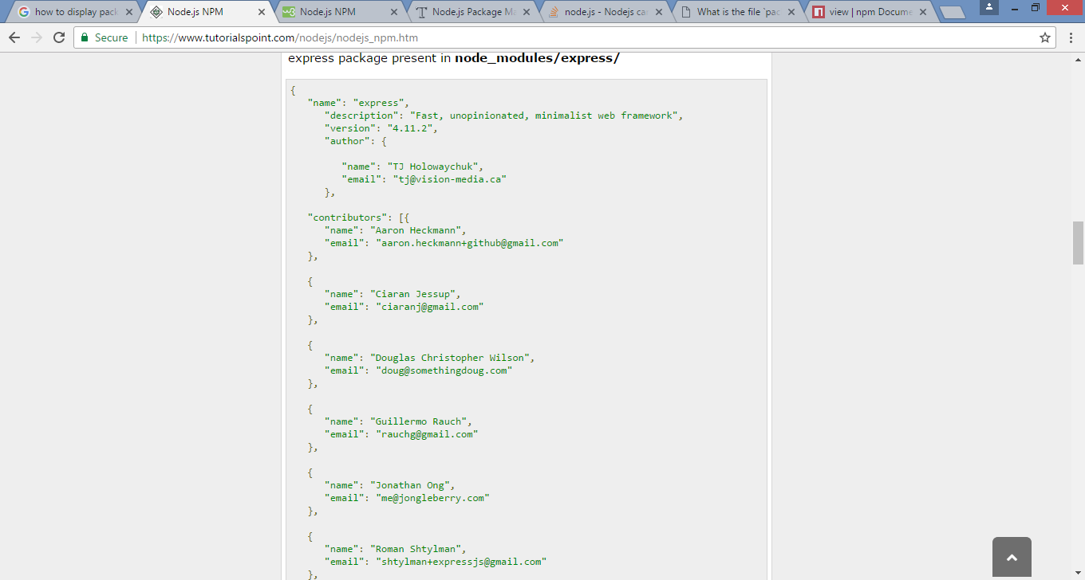

Slide 27
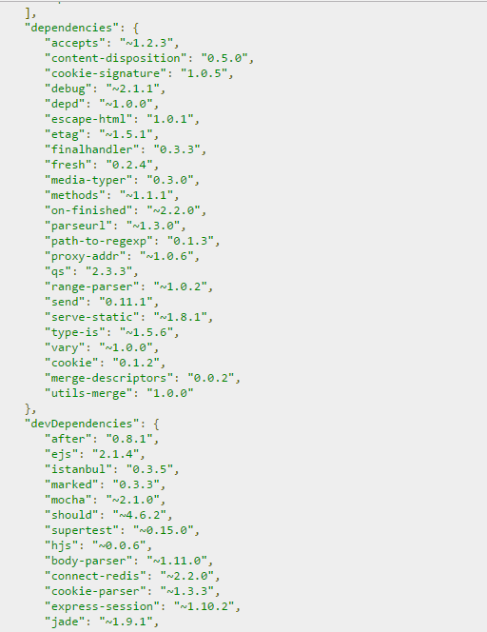
Package.json
package.json is present in the root directory of any Node application/module and is used to define the properties of a package.
This file is used to give information to npm that allows it to identify the project as well as handle the project's dependencies
Notes:
*

Slide 28
Package.json - attributes
name − name of the package
version − version of the package
description − description of the package
homepage − homepage of the package
author − author of the package
contributors − name of the contributors to the package
dependencies − list of dependencies. NPM automatically installs all the dependencies mentioned here in the node_module folder of the package.
repository − repository type and URL of the package
main − entry point of the package
keywords − keywords
Notes:
*

Slide 29
Callback concept
Callback is an asynchronous equivalent for a function.
A callback function is called at the completion of a given task.
Node makes heavy use of callbacks.
All the APIs of Node are written in such a way that they support callbacks.
This makes Node.js highly scalable, as it can process a high number of requests without waiting for any function to return results.
Notes:
*

Slide 30
Blocking code example
Create a text file named input.txt with the following content −
This is Node.js learning session
for DAC students
Create a js file named main.js with the following code −
var fs = require("fs");
var data = fs.readFileSync('input.txt');
console.log(data.toString());
console.log("Program Ended");
Now run the main.js to see the result
node main.js
Notes:
*

Slide 31
Non Blocking code example
Create a text file named input.txt with the following content −
This is Node.js learning session
for DAC students
Create a js file named main.js with the following code −
var fs = require("fs");
fs.readFile('input.txt', function (err, data) {
if (err) return console.error(err);
console.log(data.toString());
});
console.log("Program Ended");
Now run the main.js to see the result
node main.js
Notes:
*

Slide 32
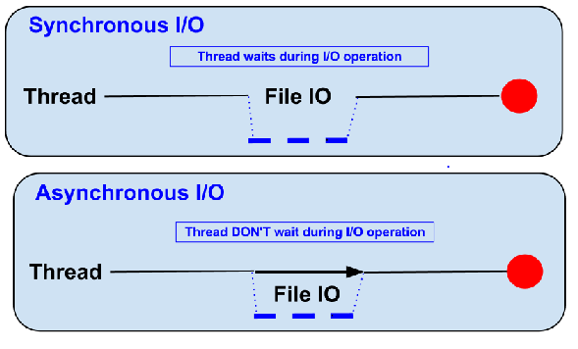
Blocking vs Non-Blocking
Notes:
*

Slide 33
event loop
Node.js is a single-threaded application, but it can support concurrency via the concept of event and callbacks.
Every API of Node.js is asynchronous and being single-threaded, they use async function calls to maintain concurrency.
Node thread keeps an event loop and whenever a task gets completed, it fires the corresponding event which signals the event-listener function to execute.
Notes:
*

Slide 34
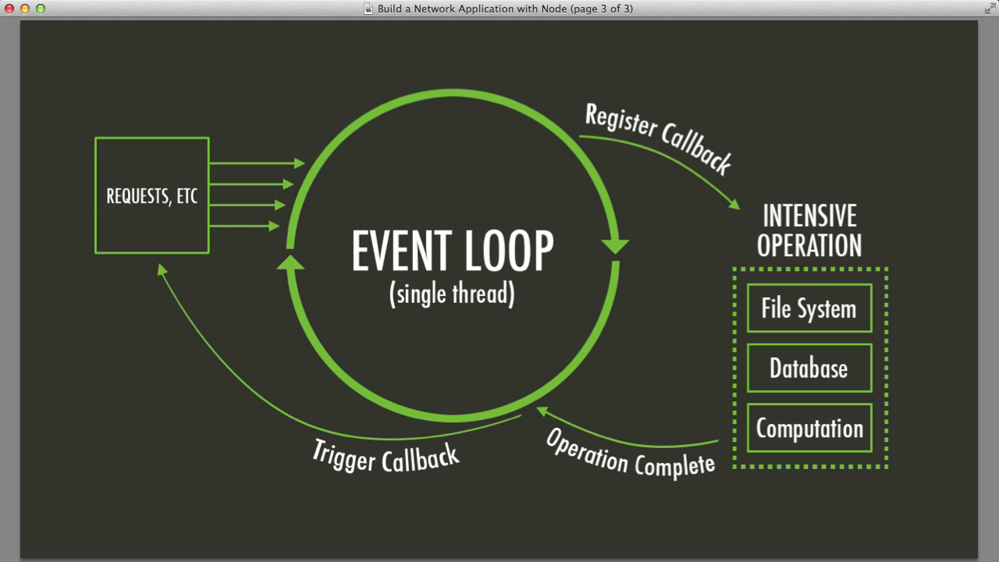
event driven programming
Event-driven programming is application flow control that is determined by events or changes in state.
The general implementation is to have a central mechanism that listens for events and calls a callback function once an event has been detected
Notes:
*

Slide 35
How Node Applications Work?
In Node Application, any async function accepts a callback as the last parameter and a callback function accepts an error as the first parameter.
This is Node.js learning session
for DAC students
var fs = require("fs");
fs.readFile('input.txt', function (err, data) {
if (err){
console.log(err.stack);
return;
}
console.log(data.toString());
});
console.log("Program Ended");
Notes:
*

Slide 36
Event emitter
An event emitter is an object that – as the name says – emits events.
For example, a net.Server emits an event each time a peer connects to it, an fs.readStream emits an event when the file is opened.
An event listner is a part of the code that binds to the event emitter and listens for certain types of events.
var fs = require('fs');
var rs = fs.createReadStream('input.txt');
rs.on('open', function () {
console.log('The file is open');
});
Notes:
*

Slide 37
Event emitter
An event emitter is an object that – as the name says – emits events.
For example, a net.Server emits an event each time a peer connects to it, an fs.readStream emits an event when the file is opened.
An event listner is a part of the code that binds to the event emitter and listens for certain types of events.
var fs = require('fs');
var rs = fs.createReadStream('input.txt');
rs.on('open', function () {
console.log('The file is open');
});
Notes:
*

Slide 38
Events Module
Node.js have a built-in module, called "Events", where you can create-, fire-, and listen for- your own events.
To include the built-in Events module use the require() method.
In addition, all event properties and methods are an instance of an EventEmitter object.
To be able to access these properties and methods, create an EventEmitter object:
// Import events module
var events = require('events');
// Create an eventEmitter object
var eventEmitter = new events.EventEmitter();
Notes:
*

Slide 39
The EventEmitter Object
You can assign event handlers to your own events with the EventEmitter object.
var events = require('events');
var eventEmitter = new events.EventEmitter();
//Create an event handler:
var myEventHandler = function () {
console.log('I hear a scream!');
}
//Assign the event handler to an event:
eventEmitter.on('scream', myEventHandler);
//Fire the 'scream' event:
eventEmitter.emit('scream');
Notes:
*

Slide 40
The EventEmitter Object
When an EventEmitter instance faces any error, it emits an 'error' event.
When a new listener is added, 'newListener' event is fired
When a listener is removed, 'removeListener' event is fired.
Notes:
*

Slide 41
EventEmitter methods
Name | Description
addListener(event, listener) | Adds a listener at the end of the listeners array for the specified event.
on(event, listener) | Adds a listener at the end of the listeners array for the specified event.
removeListener(event, listener) | Removes a listener from the listener array for the specified event.
removeAllListeners([event]) | Removes all listeners, or those of the specified event.
emit(event, [arg1], [arg2], [...]) | Execute each of the listeners in order with the supplied arguments. Returns true if the event had listeners, false otherwise.
Notes:
*

Slide 42
Node.js streams
Streams are objects that let you read data from a source or write data to a destination in continuous fashion. In Node.js, there are four types of streams −
Readable − Stream which is used for read operation.
Writable − Stream which is used for write operation.
Duplex − Stream which can be used for both read and write operation.
Transform − A type of duplex stream where the output is computed based on input.
Notes:
*

Slide 43
Node.js streams
Each type of Stream is an EventEmitter instance and throws several events at different instance of times. For example, some of the commonly used events are :
on – This event is fired when file opened.
data − This event is fired when there is data is available to read.
end − This event is fired when there is no more data to read.
error − This event is fired when there is any error receiving or writing data.
finish − This event is fired when all the data has been flushed to underlying system.
Notes:
*

Slide 44
Reading from a Stream
Create a text file named input.txt having the following content :
This is Node.js learning session
for DAC students
Create a js file named main.js with the following code:
Notes:
*

Slide 45
Reading from a Stream
var fs = require("fs");
var data = '';
// Create a readable stream
var readerStream = fs.createReadStream('input.txt');
// Set the encoding to be utf8.
readerStream.setEncoding('UTF8');
// Handle stream events --> data, end, and error
readerStream.on('data', function(chunk) {
data += chunk;
});
readerStream.on('end',function(){
console.log(data);
});
readerStream.on('error', function(err){
console.log(err.stack);
});
console.log("Program Ended");
Notes:
*

Slide 46
Reading from a Stream
var fs = require("fs");
var data = '';
// Create a readable stream
var readerStream = fs.createReadStream('input.txt');
// Set the encoding to be utf8.
readerStream.setEncoding('UTF8');
// Handle stream events --> data, end, and error
readerStream.on('data', function(chunk) {
data += chunk;
});
readerStream.on('end',function(){
console.log(data);
});
readerStream.on('error', function(err){
console.log(err.stack);
});
console.log("Program Ended");
Notes:
*

Slide 47
Writing to a Stream
Create a js file named main.js with the following code
var fs = require("fs");
var data = 'Simply Easy Learning';
// Create a writable stream
var writerStream = fs.createWriteStream('output.txt');
// Write the data to stream with encoding to be utf8
writerStream.write(data,'UTF8');
// Mark the end of file
writerStream.end();
// Handle stream events --> finish, and error
writerStream.on('finish', function() {
console.log("Write completed.");
});
writerStream.on('error', function(err){
console.log(err.stack);
});
console.log("Program Ended");
Notes:
*

Slide 48
Node.js file system
Node implements File I/O using simple wrappers around standard POSIX functions.
The Node File System (fs) module can be imported using the following syntax −
var fs = require("fs")
Notes:
*

Slide 49
Synchronous vs Asynchronous
Every method in the fs module has synchronous as well as asynchronous forms.
Asynchronous methods take the last parameter as the completion function callback and the first parameter of the callback function as error.
It is better to use an asynchronous method instead of a synchronous method, as the former never blocks a program during its execution, whereas the second one does.
Notes:
*

Slide 50
Synchronous vs Asynchronous
Create a text file named input.txt with the following content:
This is Node.js learning session
for DAC students
Let us create a js file named main.js with the following code
var fs = require("fs");
// Asynchronous read
fs.readFile('input.txt', function (err, data) {
if (err) {
return console.error(err);
}
console.log("Asynchronous read: " + data.toString());
});
// Synchronous read
var data = fs.readFileSync('input.txt');
console.log("Synchronous read: " + data.toString());
console.log("Program Ended");
Notes:
*

Slide 51
Synchronous vs Asynchronous
Create a text file named input.txt with the following content:
This is Node.js learning session
for DAC students
Let us create a js file named main.js with the following code
var fs = require("fs");
// Asynchronous read
fs.readFile('input.txt', function (err, data) {
if (err) {
return console.error(err);
}
console.log("Asynchronous read: " + data.toString());
});
// Synchronous read
var data = fs.readFileSync('input.txt');
console.log("Synchronous read: " + data.toString());
console.log("Program Ended");
Notes:
*

Slide 52
Open a File
Following is the syntax of the method to open a file in asynchronous mode
fs.open(path, flags[, mode], callback)
Parameters
path − This is the string having file name including path.
flags − Flags indicate the behavior of the file to be opened.
mode − It sets the file mode (permission and sticky bits), but only if the file was created. It defaults to 0666, readable and writeable.
callback − This is the callback function which gets two arguments (err, fd).
Notes:
*

Slide 53
Open file – flag
Flags for read/write operations are:
Flag | Description
r | Open file for reading. An exception occurs if the file does not exist.
r+ | Open file for reading and writing.
rs | Open file for reading in synchronous mode.
w | Open file for writing. The file is created (if it does not exist) or truncated (if it exists).
w+ | Open file for reading and writing.
a | Open file for appending. The file is created if it does not exist.
Notes:
*

Slide 54
Get File Information
Following is the syntax of the method to get the information about a file
fs.stat(path, callback)
Parameters
path − This is the string having file name including path.
callback − This is the callback function which gets two arguments (err, stats) where stats is an object of fs.Stats type.
Notes:
*

Slide 55
Writing a file
Following is the syntax of one of the methods to write into a file
fs.writeFile(filename, data[, options], callback)
This method will over-write the file if the file already exists.
Parameters
path − This is the string having the file name including path.
data − This is the String or Buffer to be written into the file.
options − It is an object which will hold {encoding, mode, flag}. By default. encoding is utf8, mode is octal value 0666. and flag is 'w'
callback − This is the callback function which gets a single parameter err that returns an error in case of any writing error.
Notes:
*

Slide 56
Reading a file
fs.read(fd, buffer, offset, length, position, callback)
fd − This is the file descriptor returned by fs.open().
buffer − This is the buffer that the data will be written to.
offset − This is the offset in the buffer to start writing at.
length − This is an integer specifying the number of bytes to read.
position − This is an integer specifying where to begin reading from in the file. If position is null, data will be read from the current file position.
callback − This is the callback function which gets the three arguments, (err, bytesRead, buffer).
Notes:
*

Slide 57
Closing a file
fs.close(fd, callback)
Parameters
fd − This is the file descriptor returned by file fs.open() method.
callback − This is the callback function No arguments other than a possible exception are given to the completion callback.
Notes:
*

Slide 58
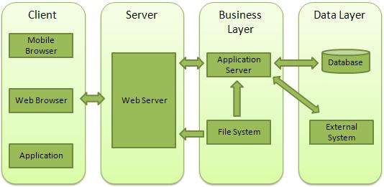
Node.js web module
A Web Server is a software application which handles HTTP requests sent by the HTTP client, like web browsers, and returns web pages in response to the clients.
Notes:
*

Slide 59
Web application architecture
A Web application is usually divided into four layers:
Client − This layer consists of web browsers, mobile browsers or applications which can make HTTP requests to the web server.
Server − This layer has the Web server which can intercept the requests made by the clients and pass them the response.
Business − This layer contains the application server which is utilized by the web server to do the required processing. This layer interacts with the data layer via the database or some external programs.
Data − This layer contains the databases or any other source of data.
Notes:
*

Slide 60
Node.js http module
Node.js has a built-in module called HTTP, which allows Node.js to transfer data over the Hyper Text Transfer Protocol (HTTP).
To include the HTTP module, use the require() method:
var http = require('http');
The HTTP module can create an HTTP server that listens to server ports and gives a response back to the client.
var http = require('http');
//create a server object:
http.createServer(function (req, res) {
res.write('Hello World!'); //write a response to the client
res.end(); //end the response
}).listen(8081); //the server object listens on port 8080
Notes:
*

Slide 61
Node.js url module
The URL module splits up a web address into readable parts.
To include the URL module, use the require() method:
var url = require('url');
Parse an address with the url.parse() method, and it will return a URL object with each part of the address as properties:
Notes:
*

Slide 62
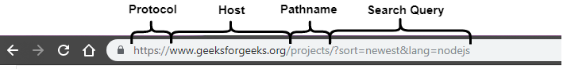
Node.js url module
Notes:
*

Slide 63
Node.js url module
var url = require('url');
var adr = 'http://localhost:8081/default.htm?year=2017&month=february';
var q = url.parse(adr, true);
console.log(q.host); //returns 'localhost:8080'
console.log(q.pathname); //returns '/default.htm'
console.log(q.search); //returns '?year=2017&month=february'
var qdata = q.query; //returns an object: { year: 2017, month: 'february' }
console.log(qdata.month); //returns 'february'
Notes:
*

Slide 64
Creating a Web Server
var http = require('http');
var fs = require('fs');
var url = require('url');
// Create a server
http.createServer( function (request, response) {
// Parse the request containing file name
var pathname = url.parse(request.url).pathname;
// Print the name of the file for which request is made.
console.log("Request for " + pathname + " received.");
// Read the requested file content from file system
fs.readFile(pathname.substr(1), function (err, data) {
if (err) {
console.log(err);
// HTTP Status: 404 : NOT FOUND
// Content Type: text/plain
response.writeHead(404, {'Content-Type': 'text/html'});
}else {
//Page found
// HTTP Status: 200 : OK
// Content Type: text/plain
response.writeHead(200, {'Content-Type': 'text/html'});
// Write the content of the file to response body
response.write(data.toString());
}
// Send the response body
response.end();
});
}).listen(8081);
// Console will print the message
console.log('Server running at http://127.0.0.1:8081/');
Notes:
*

Slide 65
Creating a web server
Next let's create the following html file named index.html in the same directory where we created server.js.
<html>
<head>
<title>Sample Page</title>
</head>
<body>
Hello World!
</body>
</html>
Notes:
*

Slide 66
Creating a web server
Now let us run the server.js to see the result −
node server.js
Verify the Output.
Server running at http://127.0.0.1:8081/
Notes:
*

Slide 67
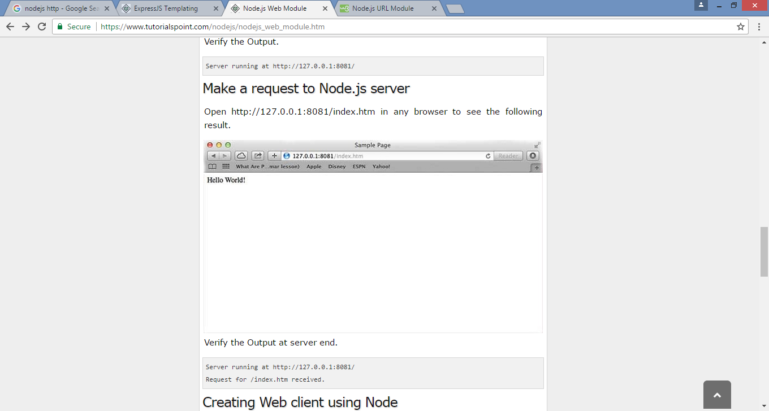
Make a request to server
Open http://127.0.0.1:8081/index.html in any browser to see the following result.
Notes:
*

Slide 68
Express framework
Express is a minimal and flexible Node.js web application framework that provides a robust set of features to develop web and mobile applications.
It facilitates the rapid development of Node based Web applications.
Following are some of the core features of Express framework −
Allows to set up middlewares to respond to HTTP Requests.
Defines a routing table which is used to perform different actions based on HTTP Method and URL.
Allows to dynamically render HTML Pages based on passing arguments to templates.
Notes:
*

Slide 69
Installing express
Install the Express framework using NPM so that it can be used to create a web application using node terminal.
$ npm install express --save
The above command saves the installation locally in the node_modules directory and creates a directory express inside node_modules.
Notes:
*

Slide 70
Hello world example
Start a server and listen on port 8081for connection. This example responds with Hello World! for requests to the homepage. For every other path, it will respond with a 404 Not Found.
var express = require('express');
var app = express();
app.get('/', function (req, res) {
res.send('Hello World');
})
var server = app.listen(8081, function () {
var host = server.address().address
var port = server.address().port
console.log("Example app listening at http://%s:%s", host, port)
})
Notes:
*

Slide 71
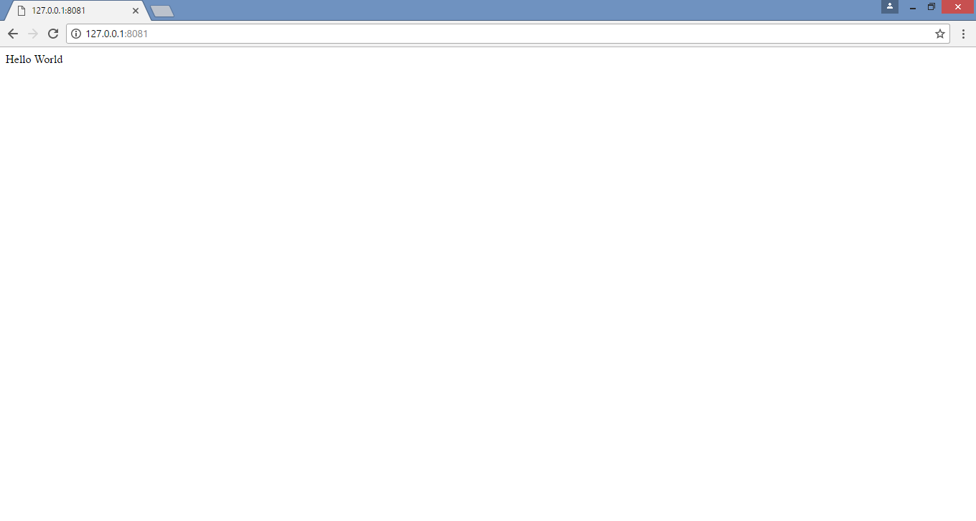
Hello world example
Open http://127.0.0.1:8081/ in any browser to see the following result.
Notes:
*

Slide 72
request and response
Express application uses a callback function whose parameters are request and response objects.
app.get('/', function (req, res) {
// --
})
Request Object − The request object represents the HTTP request and has properties for the request query string, parameters, body, HTTP headers, and so on.
Response Object − The response object represents the HTTP response that an Express app sends when it gets an HTTP request.
Notes:
*

Slide 73
Basic routing
Routing refers to determining how an application responds to a client request to a particular endpoint, which is a URI (or path) and a specific HTTP request method (GET, POST, and so on).
Notes:
*

Slide 74
Basic routing
var express = require('express');
var app = express();
// This responds with "Hello World" on the homepage
app.get('/', function (req, res) {
console.log("Got a GET request for the homepage");
res.send('Hello GET');
})
// This responds a POST request for the homepage
app.post('/', function (req, res) {
console.log("Got a POST request for the homepage");
res.send('Hello POST');
})
// This responds a DELETE request for the /del_user page.
app.delete('/del_user', function (req, res) {
console.log("Got a DELETE request for /del_user");
res.send('Hello DELETE');
})
Notes:
*

Slide 75
Basic routing
// This responds a GET request for the /list_user page.
app.get('/list_user', function (req, res) {
console.log("Got a GET request for /list_user");
res.send('Page Listing');
})
// This responds a GET request for abcd, abxcd, ab123cd, and so on
app.get('/ab*cd', function(req, res) {
console.log("Got a GET request for /ab*cd");
res.send('Page Pattern Match');
})
var server = app.listen(8081, function () {
var host = server.address().address
var port = server.address().port
console.log("Example app listening at http://%s:%s", host, port)
})
Notes:
*

Slide 76

Basic routing
Now you can try different requests at http://127.0.0.1:8081 to see the output generated by server.js.
Notes:
*

Slide 77

Basic routing
Notes:
*

Slide 78
Serving static files
Express provides a built-in middleware express.static to serve static files, such as images, CSS, JavaScript, etc.
You simply need to pass the name of the directory where you keep your static assets, to the express.static middleware to start serving the files directly.
For example, if you keep your images, CSS, and JavaScript files in a directory named public, you can do this −
app.use(express.static('public'));
Notes:
*

Slide 79
Serving static files
We will keep a few images in public/images sub-directory as follows
node_modules
server.js
public/
public/images
public/images/logo.png
Notes:
*

Slide 80
Serving static files
Let's modify "Hello Word" app to add the functionality to handle static files.
var express = require('express');
var app = express();
app.use(express.static('public'));
app.get('/', function (req, res) {
res.send('Hello World');
})
var server = app.listen(8081, function () {
var host = server.address().address
var port = server.address().port
console.log("Example app listening at http://%s:%s", host, port)
})
Notes:
*

Slide 81
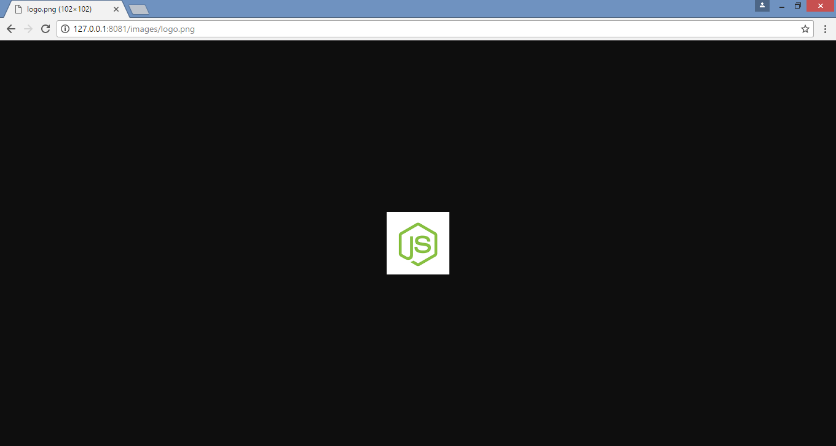
Serving static files
Notes:
*

Slide 82
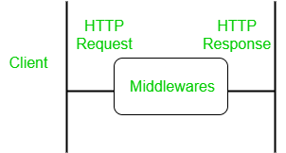
Express.js middleware
Express.js Middleware are different types of functions that are invoked by the Express.js routing layer before the final request handler.
Middleware is commonly used to perform tasks like body parsing for URL-encoded or JSON requests, cookie parsing for basic cookie handling, or even building JavaScript modules on the fly.
Middleware has the access to the request object, responses object, and next, it can process the request before the server send a response.
Notes:
*

Slide 83
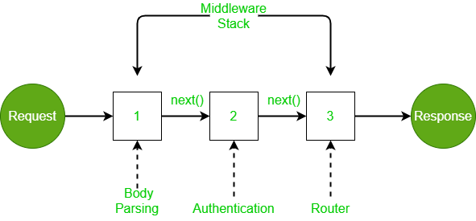
Express.js middleware
The next() function in the express is responsible for calling the next middleware function if there is one.
Notes:
*

Slide 84
Express.js template
A template engine facilitates you to use static template files in your applications.
At runtime, it replaces variables in a template file with actual values, and transforms the template into an HTML file sent to the client.
So this approach is preferred to design HTML pages easily.
Notes:
*

